Slide 1
Single Customer View Internet trends and a customer-centric world Donal Wood eBusiness Solutions Manager
26 February 2013

Slide 2
Sources
Mary Meeker 2012 Internet trends KPBC
Report by Forrester for IL on Customer Centric Stragegies

Slide 3
Basic Stats – Internet Growth Remains Robust, Rapid Mobile Adoption Still in Early Stages
Mobile communications – a revolution in front of our eyes
Reimagining almost everything
What could this mean for your business?
Economy – Mixed Trends, With Negative Bias
‘USA, Inc.’ – A Lot to be Excited About in Tech, A Lot to be Worried about in Other Areas
Bubble – or Not?

Slide 4

BASIC STATS – INTERNET GROWTH REMAINS ROBUST, RAPID MOBILE ADOPTION STILL IN EARLY STAGES

Slide 5
2.3B Global Internet Users in 2011* –
8% Growth*, Driven by Emerging Markets
 |  | 2008-2011 Internet User Adds (MMs)
1 | China | 215 | 513 | 12% | 38%
2 | India | 69 | 121 | 38 | 10
3 | Indonesia | 37 | 55 | 22 | 23
4 | Philippines | 28 | 34 | 44 | 35
5 | Nigeria | 21 | 45 | --* | 28
6 | Mexico | 19 | 42 | 19 | 37
7 | Russia | 16 | 61 | 3 | 43
8 | USA | 15 | 245 | 1 | 79
9 | Iran | 14 | 37 | --* | 48
10 | Turkey | 11 | 36 | 26 | 49
 |  | 444 663
2011 Internet Users (MMs)
Population Penetration
Rank
Country
Y/Y Growth
Top 10 | 1,189 | 12% | 32%
World | 2,250 | 8% | 32%
Note: *Nigeria / Iran data as of 12/10; Other 8 countries’ data as of 12/11, 2.3B global Internet users and 8% Y/Y growth rate based on the latest available data (most as of 12/11, some as of 12/10). Source: United Nations / International Telecommunications Union,
internetworldstats.com.
5

Slide 6
MOBILE USERS A revolution in progress
6

Slide 7
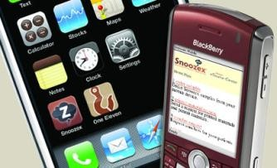
Mobile will be customers' first choice for engagement
Smartphone ownership in Ireland is already at 55% of adults, heading for 80% by end of 2013.

Slide 8
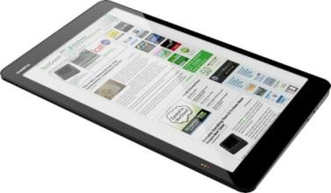
Tablet ownership is growing fast
Tablets outsold PC’s for the first time in Q3 2012.

Slide 9
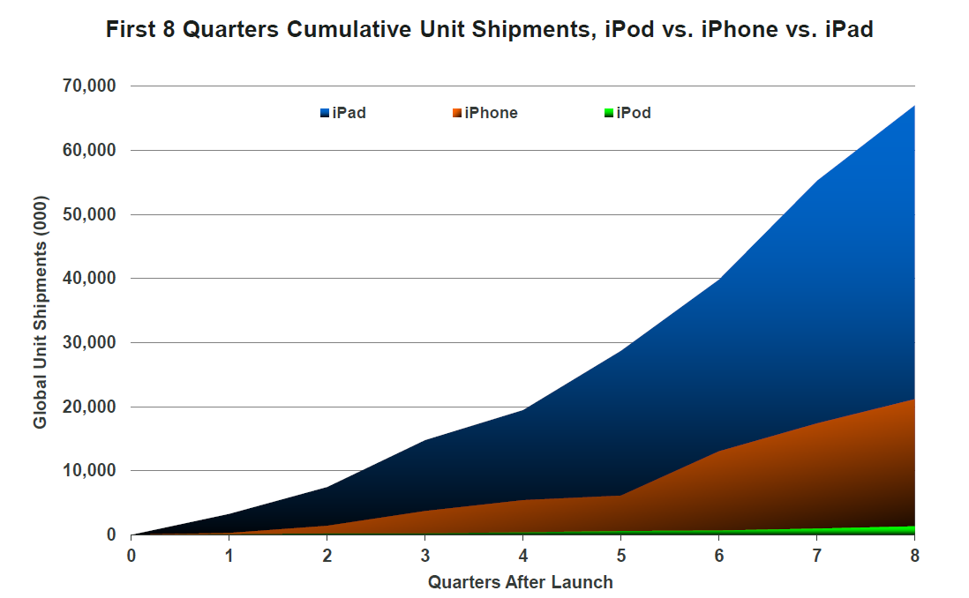


iPods Changed Media Industry…iPhones Ramped Even Faster…iPad Growth (3x iPhone) Leaves “Siblings” in Dust
Firs 8 Quarters Cumulative Unit Shipments, iPod vs. iPhone vs. iPad
1,400
iPaiPdad iPiPhhoneone iiPPoodd
20,000
1,200
₀₀₀₎0 1,000
)
0
((15,000
0
ss
^{t}nt
ene
_{mpm} 800
p
hhi
i
^{SS}10,000
i_{ni} 600
tt
n UU
l
al
^{b}oba
ol 400
l
GG
5,000
200
00
00 11 22 33 44 55 66 77 88
QQuuararterterssAAftferterLLauaunnchch
70,000
iPad iPhone iPod
60,000
Global Unit Shipments (000)
50,000
40,000
30,000
20,000
10,000
0
0
1
2
3 4
5
6
7
8
Quarters After Launch
Source: Apple, as of CQ1:12 (8 quarters post iPad launch).
9

Slide 10
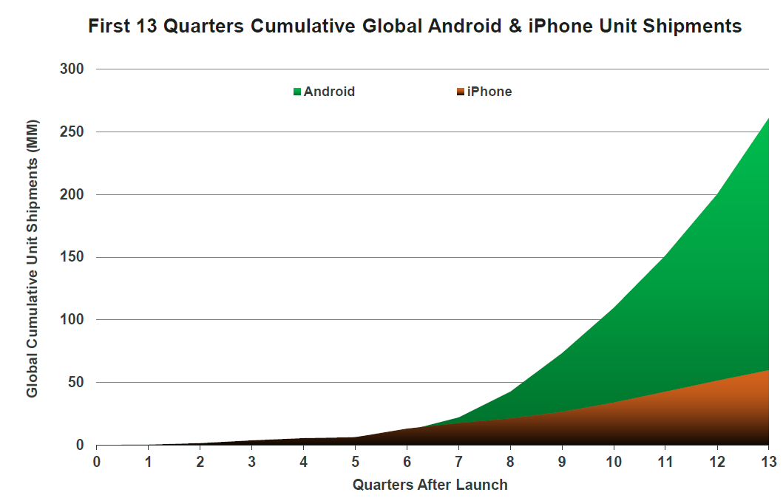

Android ‘Phone’ Adoption Has Ramped Even Faster – 4x iPhone
First 13 Quarters Cumulative Global Android & iPhone Unit Shipments
300
Android iPhone
250
300
Android iPhone
)
M 250
M (
s
nt e
_{pm} 200
hi S
t
ni
_{U} 150
e
v
i
t
a
ul
_{um} 100
C
l
oba
l 50
G
0
0 1 2 3 4 5 6 7 8 9 10 11 12 13
Quarters After Launch
Global Cumulative Unit Shipments (MM)
200
150
100
50
0
0
1
2
3
4
5 6 7 8
Quarters After Launch
9
10
11
12
13
Source: Gartner, Morgan Stanley Research, as of Q4:11.
10

Slide 11


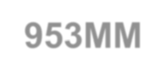

Despite Tremendous Ramp So Far, Smartphone User Adoption Has Huge Upside
Global Smartphone vs. Mobile Phone Subscriptions, Q4:11
7,000
6.1B Mobile Phone
Subscriptions
6,000
5,000
4,000
3,000
Global Subscriptions (MM)
953MM
Smartphone Subscriptions
2,000
1,000
0
Smartphone Mobile Phone
Source: Mobile phone subscriptions per Informa (as of Q4:11), Smartphone subscriptions estimate based on Morgan Stanley Research’s
estimated smartphone user as % of total mobile user at the end of 2011 (16%).
Note: While there are 1B global 3G subscribers as of Q4:11, not all of them were smartphone users. One user may have multiple mobile 11
subscriptions, therefore actual user #s may be lower than subscriber #s.

Slide 12
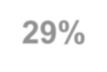











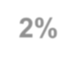








Impressive 29% of USA Adults Own Tablet / eReader, Up from 2% Less Than Three Years Ago
% of USA Adults Who Own Tablet Computers or eReaders, 4/09 – 1/12
35%
USA Adults that own tablet computers or eReaders (%)
29%
30%
25%
20%
15%
10%
5%
2%
0%
4/09
9/09
5/10
9/10
11/10
5/11
8/11
12/11
1/12
Source: Pew Research Center, 1/12.
12

Slide 13
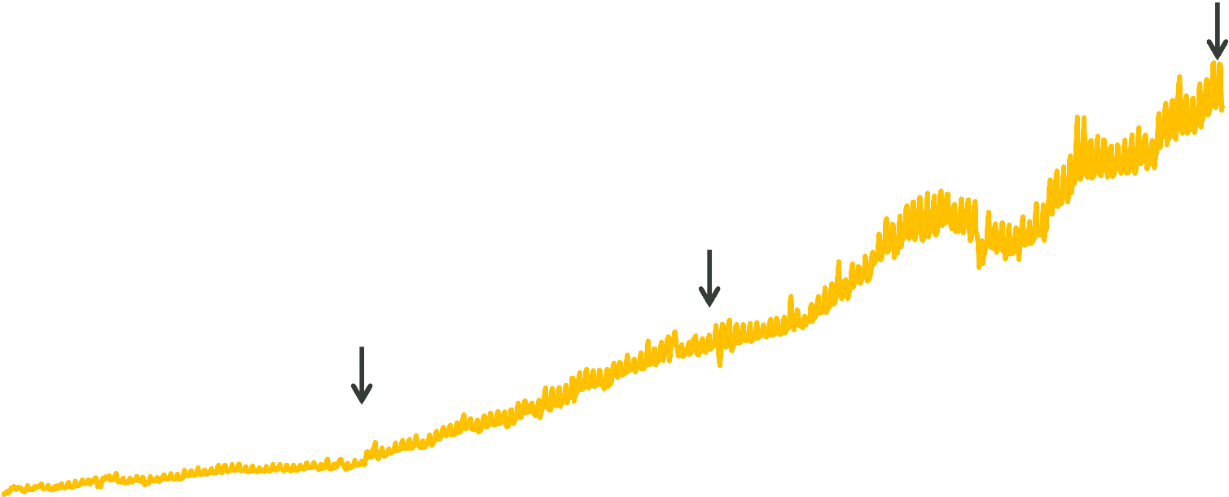
Good News =
Global Mobile Traffic Growing Rapidly to 10% of Internet Traffic
Global Mobile Traffic as % of Total Internet Traffic, 12/08 – 5/12
15%
10% in 5/12
10%
4% in 12/10
% of Internet Traffic
5%
1% in 12/09
0%
12/08
4/09
8/09
12/09
4/10
8/10
12/10
4/11
8/11
12/11
4/12
Source: StatCounter Global Stats.
14

Slide 14
Good News =
Mobile @ 8% of USA eCommerce & Helping Accelerate Growth
USA eCommerce Y/Y Growth vs. Mobile Commerce as % of Total eCommerce, Q1:10 – Q1:12
20% 20%
USA eCommerce Y/Y Growth
USA Mobile Commerce as % of eCommerce
eCommerce Y/Y Growth Rate
Mobile Commerce as % of Total eCommerce
15%
15%
10%
10%
5%
5%
0%
0%
Q1:10
Q2:10
Q3:10
Q4:10
Q1:11
Q2:11
Q3:11
Q4:11
Q1:12
Source: comScore.
15

Slide 15






Good News =
Mobile Monetization Growing Rapidly (71% Apps, 29% Ads)
Global Mobile App + Advertising Revenue, 2008 vs. 2011E
$15
Mobile Apps Mobile Advertising
Mobile Ad + Apps Spending ($B)
$12B
$10
$5
$0.7B
$0
2008
2009
2010
2011E
Source: Gartner. CAGR is compound annual growth rate. Note: Apple has paid >$3B $’s to developers as of 9/11, implying gross app market revenue of $4B in 3 years; Google indicated during
CQ3 earnings call that it expects $2.5B mobile ad revenue in 2011E
16

Slide 16













Good News =
Material Upside for Mobile Ad Spend vs. Mobile Usage
% of Time Spent in Media vs. % of Advertising Spending, USA 2011
Time Spent
Ad Spend
% of Total Media Consumption Time or Advertising Spending
50%
Internet Ad Mobile Ad
= $30B* = $1.6B*
40%
43% 42%
30%
26%
~$20B+
20%
25%
Opportunity
22%
in USA
10%
15%
11%
10%
7%
1%
0%
Print Radio TV Internet Mobile
Note: *Internet (excl. mobile) advertising reached $30B in USA in 2011 per IAB, Mobile advertising reached $1.6B per IAB. Print includes newspaper and magazine. $20B opportunity calculated assuming Internet and Mobile ad spend share equal their respective time spent
share. Source: Time spent and ad spend share data eMarketer, 12/11, Internet and mobile ad dollar spent amount per IAB.
17

Slide 17
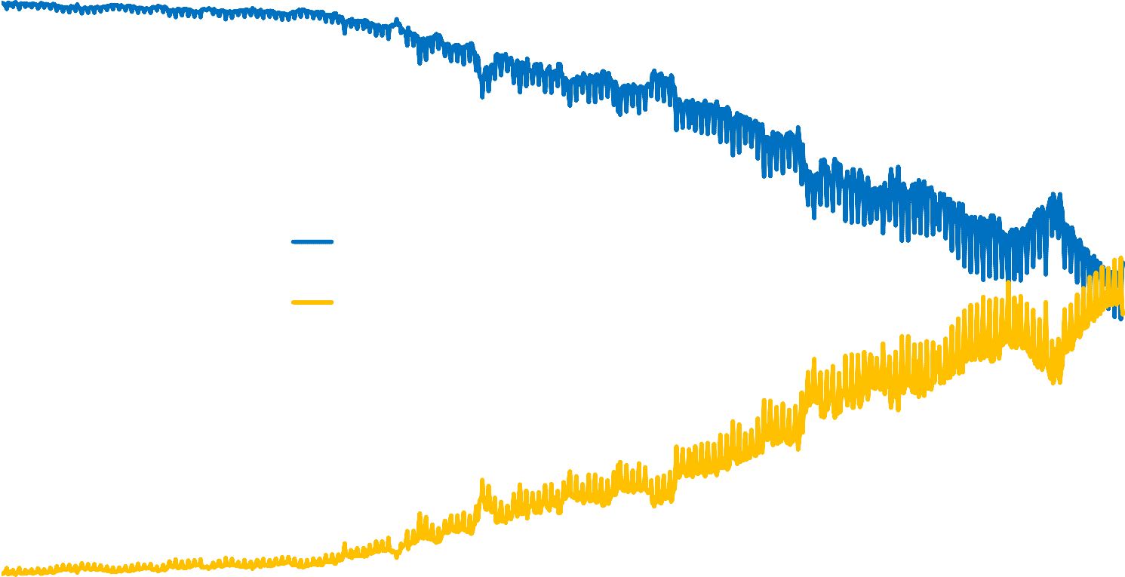
Good / Bad News – Rapidly Growing Mobile Internet Usage Surpassed More Highly Monetized Desktop Internet Usage in May, 2012, in India
India Internet Traffic by Type, Desktop vs. Mobile, 12/08 – 5/12
100%
80%
% of Internet Traffic
60%
Desktop Internet Mobile Internet
40%
20%
0%
12/08
4/09
8/09
12/09
4/10
8/10
12/10
4/11
8/11
12/11
4/12
Source: StatCounter Global Stats.
18

Slide 18
RE-IMAGINATION OF NEARLY EVERYTHING* –
POWERED BY NEW DEVICES + CONNECTIVITY + UI + BEAUTY – WHERE WE ARE NOW…
*Note that this section includes more slides than were presented at D10 Conference, May 30, 2012.
29

Slide 19
First Generation of Re-Imagination - After 125 Years, Landlines Were Surpassed by Mobiles in 2002
Global Fixed Telephone Lines vs. Mobile Subscriptions, 1994 - 2009
5,000
Global Installed Base (MMs)
Fixed Telephone Lines
2009
4.7B Mobile
4,000
Mobile Subscriptions
Subscribers
3,000
2002: Inflection Point
Mobiles > Landlines
2006
Landlines
2,000
Peaked at 1.3B
1,000
0
1994
1996
1998
2000
2002
2004
2006
2008
Source: International Telecommunications Union.
30

Slide 20
First Generation of Re-Imagination – After 244 Years, Encyclopedia Britannica is Going Out of Print in 2012
Encyclopedia Britannica Hard Copy Sales, 1990 – 2011
150
1990 – Sales
Peaked at 120K/year
Annual Hard Copy Sales (000)
1993 – Microsoft Introduced Encarta Encyclopedia for PC
@ $99
100
2001 – Wikipedia Founded, Today* Wikipedia Has 470MM Monthly Unique Users
2012 – Encyclopedia Britannica Announced End of Print Editions
50
2008 – Microsoft Shut Down Encarta
0
1990
1993
1996
1999
2002
2005
2008
2011
Note: *as of 4/12, per comScore global data.
31
Source: Kellog School of Management, Shane Greenstein and Michelle Devereux, “The Crisis at Encyclopedia Britannica.”

Slide 21
First Generation of Re-Imagination – After 305 Years,* Newspaper Ad Revenue Was Surpassed by Internet in 2010
U.S. Newspaper (Print) Advertising vs. Internet Advertising Spending, 1995 - 2010
$50
$40
$30
$20
$10
$
U.S. Advertising Spend ($MM)
1995
1997
1999 2001 2003
2005
Internet
2007
2009
Newspaper (Print)
Newspaper Trendline (2006-2010) Internet Trendline (2006-2010)
Note: *America’s first newspaper ad appeared in 1704 in a Boston local newspaper, per AdAge. Internet advertising includes online
newspaper advertising. Source: Print newspaper ad spending per Newspaper Association of America (NAA); Internet ad spending per
Interactive Advertising Bureau (IAB).

Slide 22
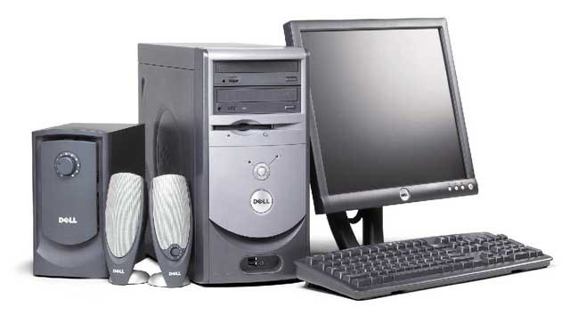
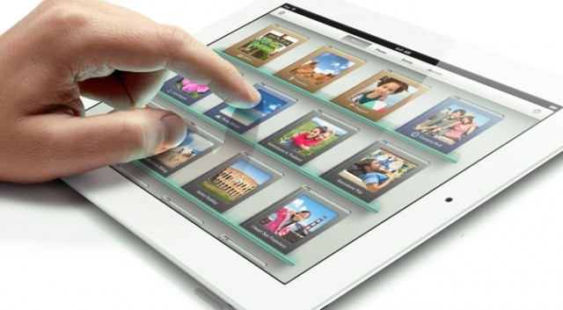
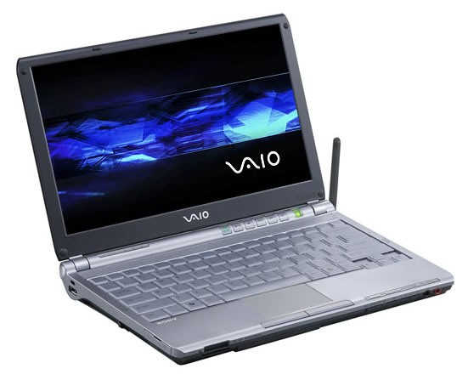
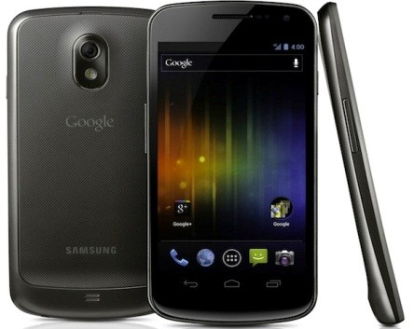
Re-Imagination of Computing Devices…
THEN…
(Desktops / Notebooks)
NOW…
(Tablets / Smartphones)

Slide 23
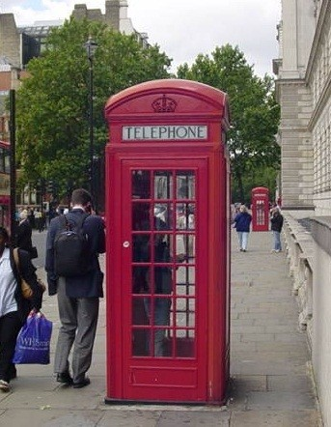

Re-Imagination of Connectivity…
THEN…
NOW…

Slide 24
…Re-Imagination of Connectivity
We hope to rewire the way people spread and consume information…We think a more open and connected world will help create a stronger economy with more authentic businesses that build better products and services.
- Mark Zuckerberg, Founder / CEO, Facebook Letter to Potential Shareholders, May 2012

Slide 25
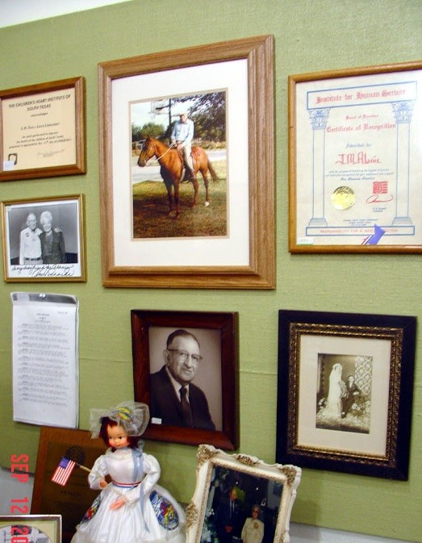
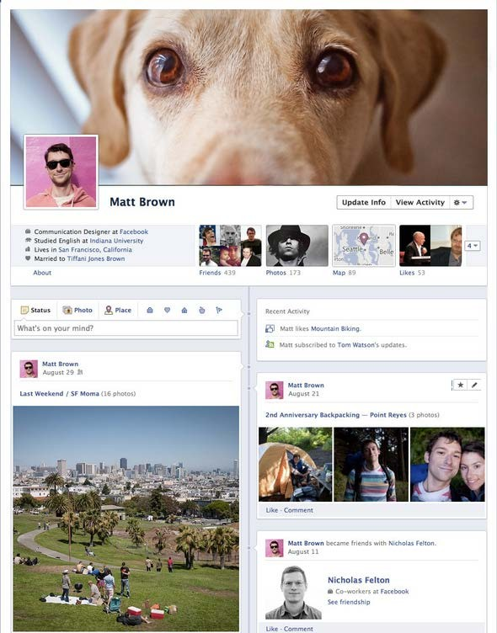
Re-Imagination of Life Stories…
THEN…
Biographies / Item Exhibitions For Famous People or Loved Ones
NOW…
(Facebook Timeline)
Broad Personalized Media Discovery Feed / Automatically Created / Widely Accessible

Slide 26
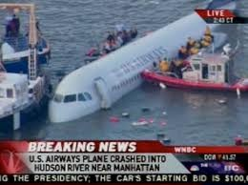
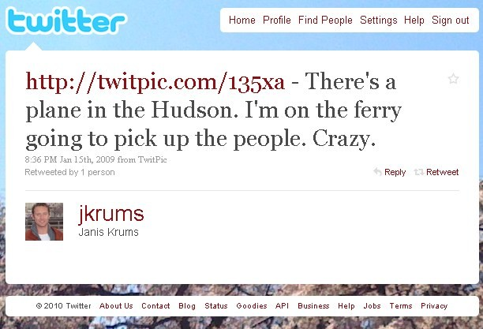

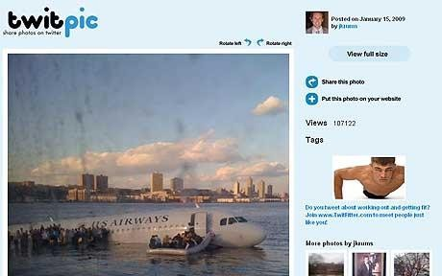
Re-Imagination of News + Information Flow…
THEN…
Delayed / Dedicated Reporters + Cameramen / Regional or National Reach
NOW…
(Twitter)
Real-Time / Citizen Reporting via Mobile Devices / Global Reach

Slide 27

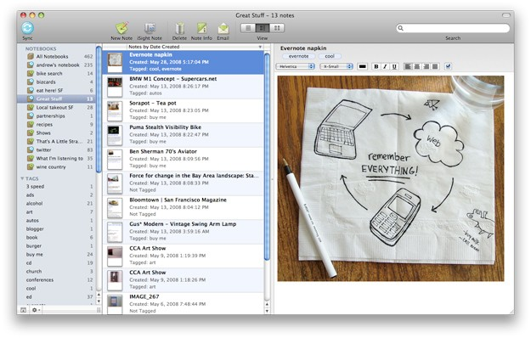
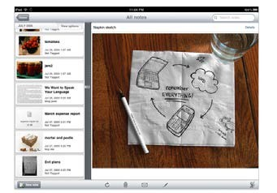
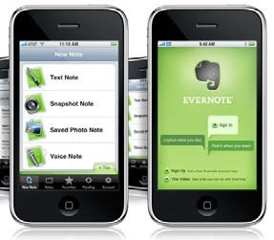
Re-Imagination of Note Taking…
THEN…
Pencil + Notepad
NOW…
(Evernote)
Always Synced / Multi-Device / Picture + Audio Enabled / Searchable

Slide 28

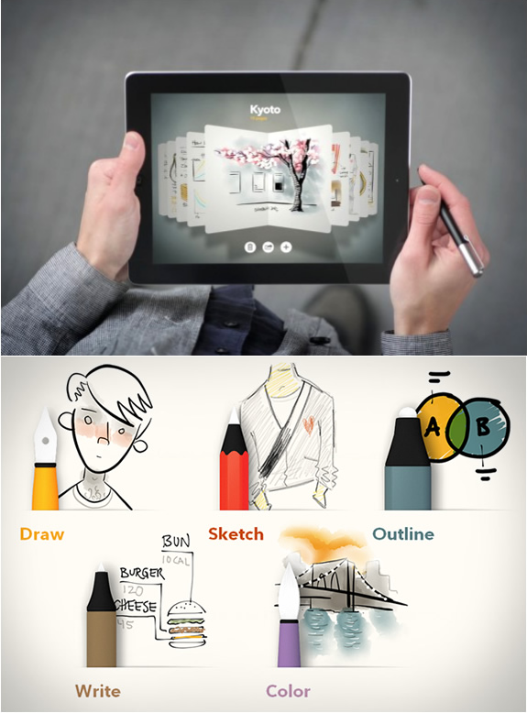
Re-Imagination of Drawing…
THEN…
Dedicated Canvas / Paint Supplies / Studios
/ Limited Distribution
NOW…
(Paper by Fiftythree…) Reusable Canvas (Screen) / Creating Art Anywhere Anytime / Digitally Enhanced
Creation Tools / Instant Sharing

Slide 29
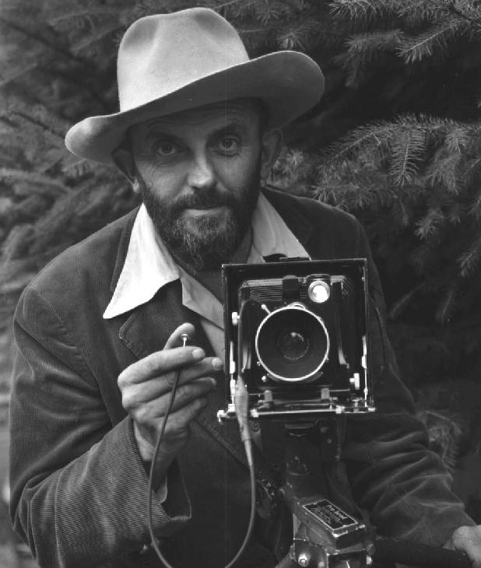
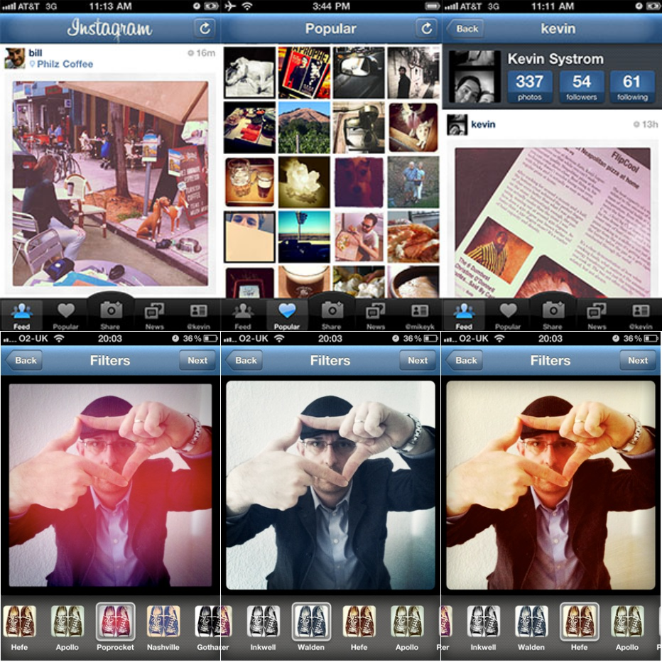
Re-Imagination of Photography…
THEN…
Dedicated Camera / Manually Transfer Digital Files / Develop Films
NOW…
(Instagr.am / Camera+ / Hipstamatic…) Always With You Camera (Smartphone) / Instant Digital Effects / Share / Sync / Discover

Slide 30
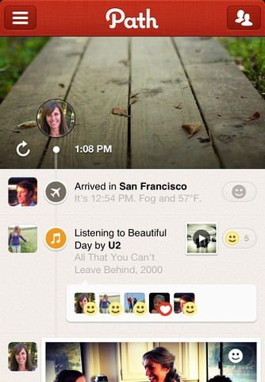
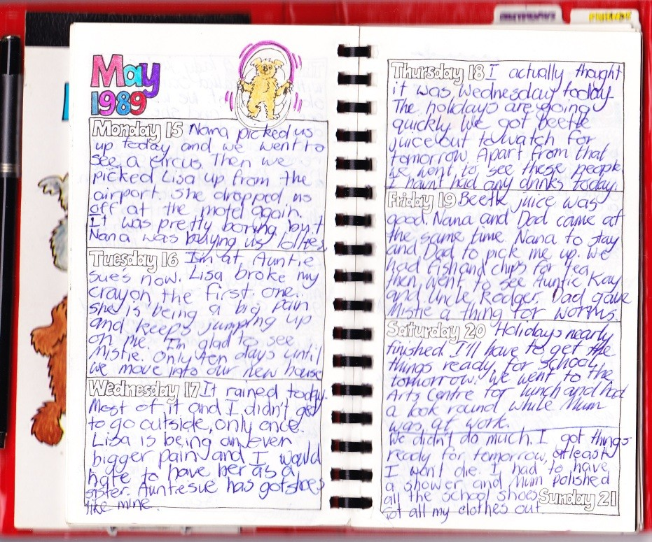
Re-Imagination of Diaries…
THEN…
Hand-Written / Drawn
NOW…
(Path)
One-Tap to Add Entry / Multimedia / Location-Aware / Share / Search

Slide 31
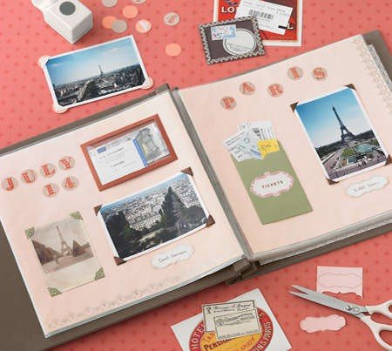
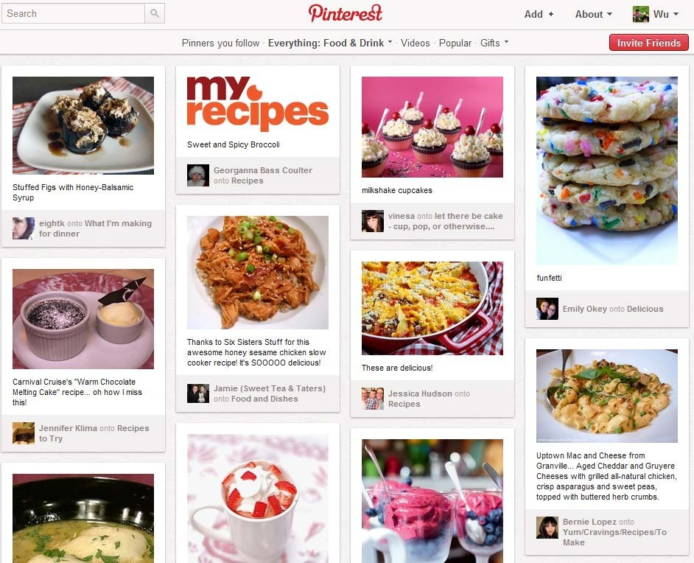
Re-Imagination of Scrapbooking / Aspiration…
THEN…
Paper / Scissors / Glue
NOW…
(Pinterest)
One-Click to Pin / Share / Follow / Always Accessible

Slide 32
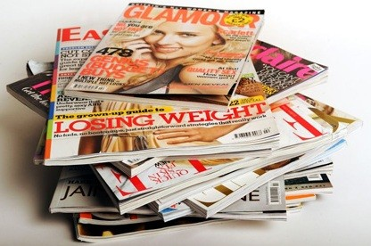
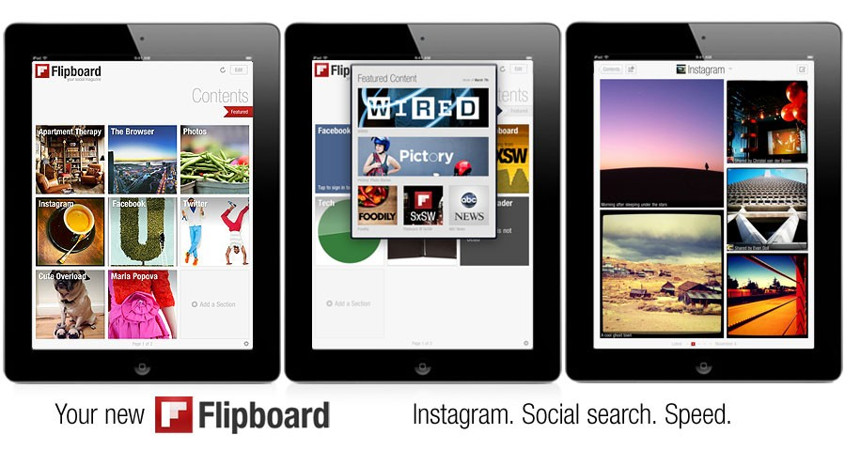
Re-Imagination of Magazines…
THEN…
Piles of Print Copies
NOW…
(Flipboard)
More Content / Always Up-To-Date / Personalized / Access Everywhere / Interactive (Video + Audio) / Share

Slide 33
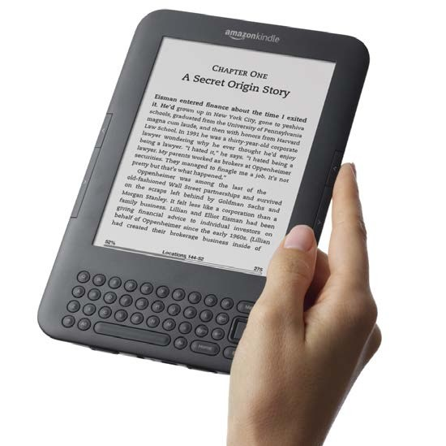

Re-Imagination of Books…
THEN…
NOW…
(Amazon Kindle / Apple iBooks)

Slide 34
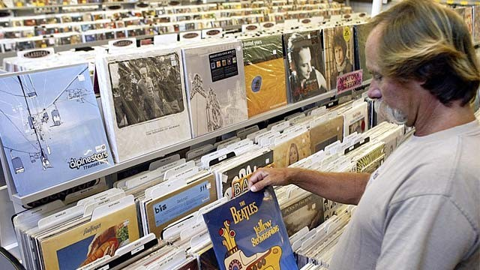
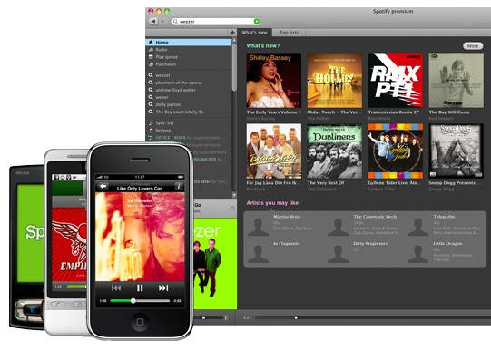
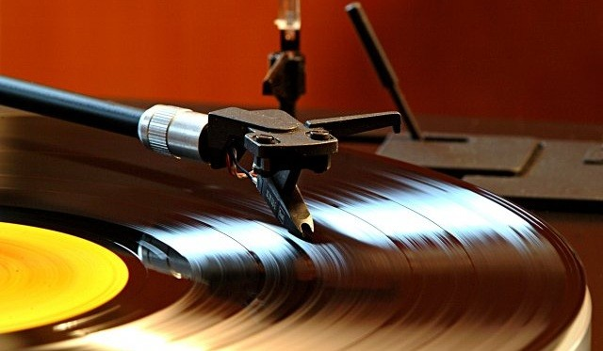
Re-Imagination of Music…
THEN…
Buy Albums + CDs in Stores / Playback via Dedicated Players
NOW…
(Spotify…)
Discovery of Music Through Friends + Experts / Instant On-Demand Streaming on Internet- Enabled Devices

Slide 35
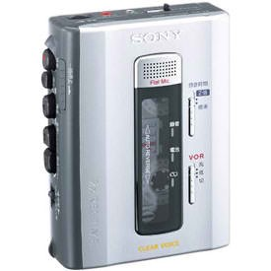
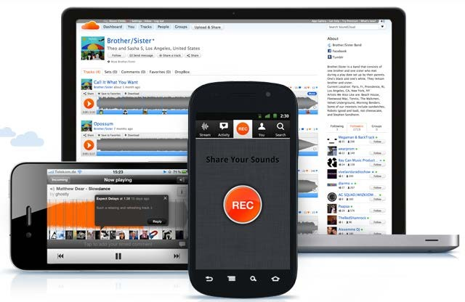
Re-Imagination of Sound…
THEN…
Tape Recorder / Hard to Edit / Share
NOW…
(SoundCloud)
Record / Edit / Upload / Playback Anywhere / Anytime / On Any Device / Playlist sharing / Discovery

Slide 36
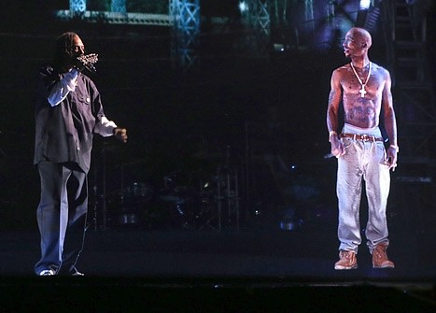
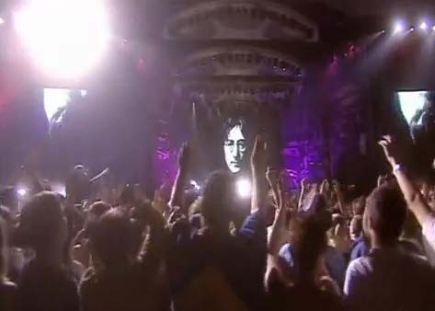
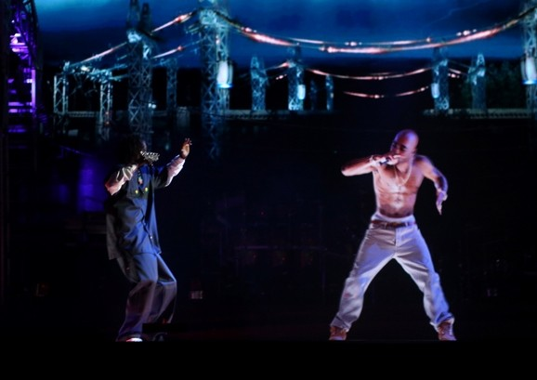
Re-Imagination of Artists / Concerts…
THEN…
Big Screen Tributes
NOW…
(Tupac @ Coachella…)
3D / Life-Like / Programmable Hologram / Bringing Past Icons Back to Life

Slide 37
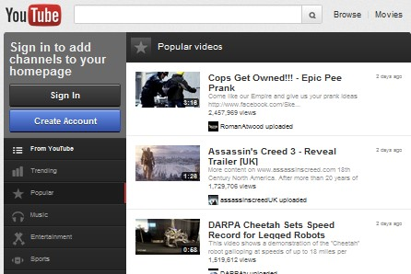
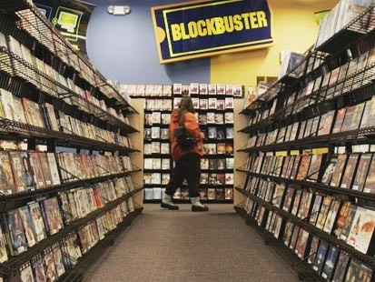
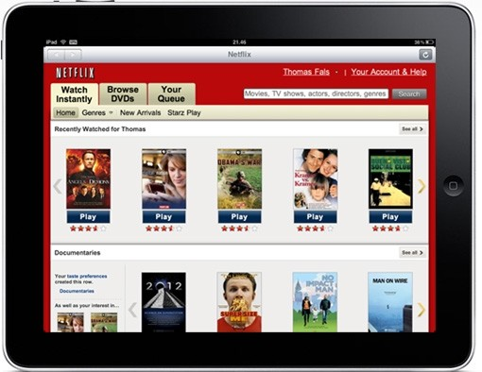
Re-Imagination of Video…
THEN…
Physical Retail / Rental Stores
NOW…
(YouTube / Netflix…)
On-Demand / Instant Streaming / Accessible Everywhere

Slide 38
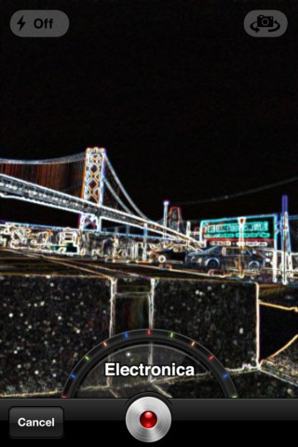
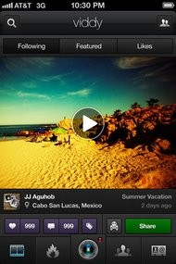
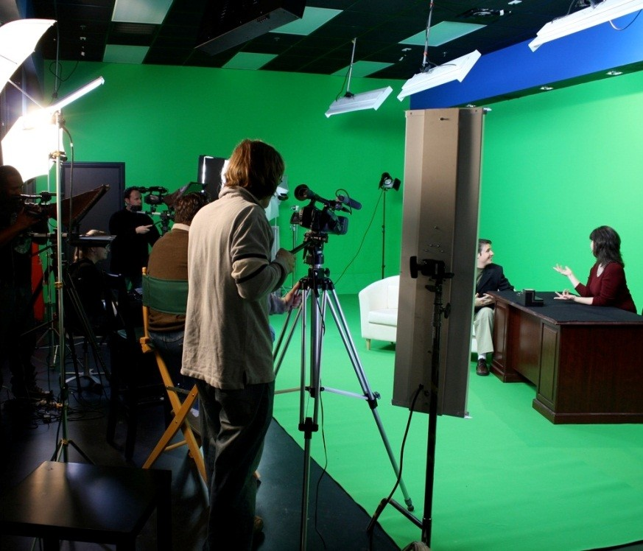
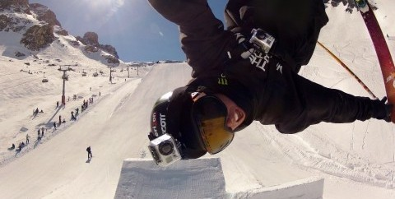
Re-Imagination of Video Creation / Production…
THEN…
Dedicated Set / Camera / Lighting / Editing Equipment
NOW…
(SocialCam / Viddy / GoPro…) Live Digital Effects / Wearable Recording Device / Real-Time Upload / Discovery

Slide 39
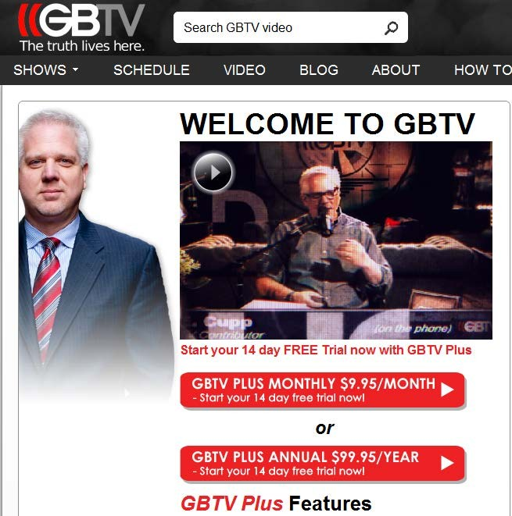
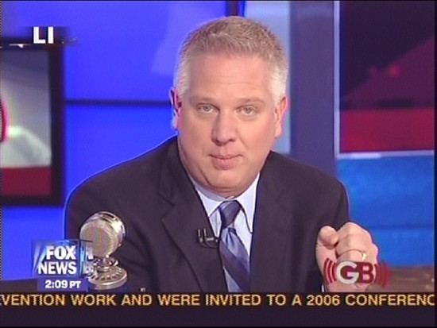
Re-Imagination of Distribution + Monetization for ‘Talent’…
THEN…
(Glenn Beck on Fox News)
NOW…
(GBTV - Digital)
With 300K Subscribers + Lower Production Costs, GB Making Materially More Money

Slide 40
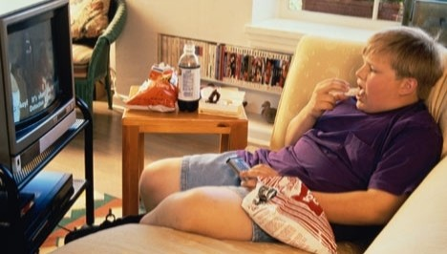



Re-Imagination of Home Entertainment…
THEN…
Lean Back / Lean Forward
NOW…
(Chill…)
Curl Up – Visual Layout / Social Discovery / Distribution / Interaction

Slide 41




Re-Imagination of TV…
THEN…
Linear Programming / Pre-Set Channels / Little Control Over Content
NOW…
(YouTube Channels / Bleacher Team Stream…)
On Demand Personalized Content on Big Screen

Slide 42



Re-Imagination of Communication…
THEN…
Dedicated Devices / Limited Function & Range / Intrusive
NOW…
(Voxer…)
Push-To-Talk / Voice Message / Picture / Text / Location / Group Chat

Slide 43


Re-Imagination of Navigation + Live Traffic Info…
THEN…
Physical Copies of Map in Car / TV, Radio Reporting of Traffic Info
NOW…
(Waze)
User-Generated Digital Map / Live Crowd-Sourced Traffic Data

Slide 44


Re-Imagination of Sports Info…
THEN…
Professional Commentators / Reporters / Limited Coverage & Reach
NOW…
(Bleacher Report)
Anyone Can Be a Contributor / Opinion-Oriented Analysis / Multimedia / Social & Mobile Enabled

Slide 45





Re-Imagination of Home Improvement…
THEN…
Magazines / Cable TV Channels / Limited Interaction With Consumers
NOW…
(Houzz / One Kings Lane…) Communication Platform for Designers & Consumers / Share / Discover & Click-And-Buy

Slide 46


Re-Imagination of Calling a Cab…
THEN…
Long Lines During Rush Hours / Rain / Some Areas May Not Have Taxis Roaming on Streets
NOW…
(Uber)
One-Tap Taxi Call / Location-Aware / Electronic Payment

Slide 47





Re-Imagination of Cars…
THEN…
Gasoline / Diesel Powered Internal Combustion Engine With Exhaust
NOW…
(Hybrid / Electric Cars)
Plug-in Electrical Powertrain / Regenerative Brake / Solar Panel Roof / Little-to-Zero Emission

Slide 48


Re-Imagination of Yellow Pages…
THEN…
Big Heavy Printed Business Listings / No Reviews / No Easy Search Feature
NOW…
(Yelp…)
User Reviews / Pictures / Recommendations / Location-Aware / Easily Searchable

Slide 49



Re-Imagination of Coupons + Local Services…
THEN…
Non-Personalized / Smaller Discounts / Easily Lost or Forgotten
NOW…
(Groupon…)
Personalized / Location-Aware / Instant Deals / Group-buying Discount

Slide 50



Re-Imagination of Getting Food Quickly…
THEN…
Permanent Store Locations
NOW…
(Kogi Food Truck…)
~100K Twitter Followers / Real-Time Location Updates

Slide 51


Re-Imagination of Cash Registers…
THEN…
Big + Odd Looking Machines / Receipt Printers Cash Drawers
NOW…
(Square)
Simple + Elegant Tablet + Square Reader / Email Receipts / Touch Signing

Slide 52



Re-Imagination of Window Shopping…
THEN…
NOW…
(One Kings Lane / Fab)
Click & Buy

Slide 53


Re-Imagination of Marketplaces…
THEN…
Tent + Pickup Truck @ Street Fairs
NOW…
(Etsy)
Integrated Platform For Listings / Advertising / Payment / Inventory Management

Slide 54



Re-Imagination of Manufacturing…
THEN…
Mass Production of High-Volume Standardized Items
NOW…
(Zazzle / Shapeways)
Customized / Personalized Design / 3D Printing Process

Slide 55
Magnitude of Upcoming Change Will be Stunning - We are Still in Spring Training
Nearly Ubiquitous High-Speed Wireless Access in Developed Countries
Unprecedented Global Technology Innovation
Ultra Competitive Markets for Mobile Operating Systems + Devices
Broadly Accepted ‘Social Graphs’ / Information Transparency
Fearless (& Connected) Entrepreneurs
Difficult ‘What Do I Have to Lose’ Economic Environment for Many
Available (& Experienced) Capital
Fearless (& Connected) Consumers
Inexpensive Devices / Access / Services (Apps)
Ability to Reach Millions of New Users in Record (& Accelerating) Time
‘Social Emerging as Starting Distribution Point for Content,’ (Brian Norgard, Chill)
Aggressive (and Informed) ‘On My Watch’ Executives at ‘Traditional’ Companies
Unprecedented Combo of Focus on Technology AND Design
Nearly ‘Plug & Play’ Environment For Entrepreneurs – Marketplaces / Web Services / Distributed Work / Innovative Productivity Tools / Low ‘Start Up’ Cost
Beautiful / Relevant / Personalized / Curated Content for Consumers

Slide 56
Implications for business

Slide 57
Enabling Lifetime Customer Relationships
Acquire > | Onboard > | Serve > | Grow > | Retain
Optimized Customer Relationship
Value
$0
Untapped
Value
Typical Customer Lifecycle
Suspect/ Prospect | Customer | Active Customer | Best Customer | Advocate
Optimizing Customer Interactions

Slide 58


Investors now looking at Customer Value KPIs
Research has demonstrated quite conclusively that customer value is an excellent proxy for firm value and that companies investing in customer-centric initiatives enjoy higher financial returns.
NPS & Other Customer Satisfaction measures
Employee satisfaction
Customer Relationship Health Value
CLTV – Customer Life Time Value
Product density – cross sell rates
Marketing consents
Customer Engagement
In a long term industry, all are considered good indicators of the
long term fortune of a company

Slide 59






Using more information leads to better results
First Browsing
Interaction
Multiple Browsing
Interactions
First Manned
Interaction
After First
Review
Relationship
Customer
Networked
Advocate
Anonymous
Intimate
J Smith
087-12345678
Joanna Smith,
Mobile 087-1234578
Email – jsmith@gmail.com
Joanna Smith
Female
Age 29
Mallow, Co Cork
Married to Dave with 1 child
Semi-State Employment
Protection need
Email only please
Joanna Smith
Needs to know she is not wasting money
Wants to know she is making the right decision now, for her family’s future
Wants to tell her friends she found it surprisingly easy to deal with Irish Life as they understood her.
Understanding
Every conversation is an opportunity and a responsibility

Slide 60

Customer Centric Virtuous Circle
This is a long-term play that means more work but better results
Up sell
+
Cross sell
+
Persistency
+
Word of Mouth
+
New sales
Needs engagement from all parts of the business and seamless interaction between sales and service

Slide 61


Add explicit value
Customer engagement activity tailored for the different stages – but as individuals

Slide 62
Customer Centricity
Customer-centricity in today’s consumer context
Why customer intelligence matters today
Value of data and analytics in the insurance industry
Examples of customer intelligence in insurance
In ‘old-fashioned speak’ know your customer
© 2012 Forrester Research, Inc. Reproduction Prohibited

Slide 63

We have entered the “Age of the Customer”
Customers now have easy access to:
Product information
Company information
Competitor information
The opinions of friends
The “impartial” opinion of strangers
Source: June 2011 “Competitive Strategy In The Age Of The Customer” Forrester report

Slide 64

Customer obsession?
A customer-obsessed company focuses its strategy, its energy, and its budget on processes that enhance knowledge of and engagement with customers and prioritizes these over maintaining traditional competitive barriers.
You want to compete? Get customer obsessed!
Nimble, emphasizing speed over strength Flexible, valuing versatility over lock-in
Global, embracing worldwide supplies, demands, and markets
Smart, providing information-rich services over dumb products or transactions

Slide 65
What’s causing this shift?
© 2012 Forrester Research, Inc. Reproduction Prohibited

Slide 66




The rapid digitization of our lives
65% of Irish consumers say they use the internet as their primary source of information about goods and services.

Slide 67

Customers are becoming increasingly self-directed
Direct channels gaining traction, online research is increasing.
Source: Forrester Research European Technographics® & “Trends 2012: European Insurance Ebusiness and Channel Strategy” Forrester report

Slide 68

Comparison sites continue to gain traction
The percentage of European insurance buyers who used a comparison site to research their policy rose from 6% in 2007 to 21% in 2011.
Source: Forrester Research European Technographics® & “Trends 2012: European Insurance Ebusiness and Channel Strategy” Forrester report

Slide 69
As a result….
© 2012 Forrester Research, Inc. Reproduction Prohibited

Slide 70


Consumers become always
addressable
Spend shifts online

Slide 71


Purchase paths expand
Data becomes the new oil

Slide 72

CRM solutions are widely used
Source: February 16, 2012, “Navigate The Future Of CRM” Forrester report

Slide 73





But in reality very few companies deliver an outstanding
customer experience
OK
Good Poor
Excellent
Very poor
10% 3%
23% 31% 34%
Base: 154 large North American brands score in Forrester’s Customer Experience Index, 2012
®
Source: North American Technographics Customer Experience Online Survey, Q3 2007, Q4 2008, Q4 2009 (US), Q4 2010 (US), Q4 2011 (US)

Slide 74


Few firms excel at customer experience
Source: January 2012 “The Customer Experience Index, 2012” Forrester report

Slide 75
Why does it matter?
© 2012 Forrester Research, Inc. Reproduction Prohibited

Slide 76

Customer experience correlates to loyalty
Willingness to consider for another purchase
Likelihood to
recommend to a friend
Likelihood to switch
business to a competitor

Slide 77

Customers who had a good experience
invested 4.5x more money with Fidelity
Their investments added up to billions of incremental dollars per year

Slide 78
How do we address this?
© 2012 Forrester Research, Inc. Reproduction Prohibited

Slide 79
Customer-centric culture
A system of shared values and behaviors that focus employee activity on improving customer experience

Slide 80

PUT THE CUSTOMER AT THE CENTER OF ALL DECISIONS

Slide 81



Slide 82
Customer intelligence matters now more
than ever…
© 2012 Forrester Research, Inc. Reproduction Prohibited

Slide 83





CI’s time has come!

Slide 84
What’s happening in CI today?
Trends to watch out for:
Data capture extending beyond traditional sources
Increasingly complex data integrations
Higher demand for real-time intelligence
More Customer Intelligence applications throughout the entire business

Slide 85

Data capture extending beyond traditional sources
In response to:
Unstructured data
The Splinternet
Schizophrenic customer
segmentation

Slide 86

Increasingly complex data integrations
In response to:
Online and offline customer data sources
Increasingly online marketing suite
Data-as-a-service options

Slide 87

Higher demand for real-time intelligence
In response to:
Increasing testing velocity
Scarce analytics resources
Mandate for multichannel fractional
attribution

Slide 88

More Customer Intelligence applications throughout the
entire business
In response to:
Advances in targeted advertising
Evolving and maturing CI teams
Domination of Social Intelligence

Slide 89













Leading companies use customer data effectively to
drive customer obsession

Slide 90
How does this relate to the insurance
industry?
© 2012 Forrester Research, Inc. Reproduction Prohibited

Slide 91

Customer data and analytics plays a key role in each
stage of insurance buyer’s interactions
Comparison shopping
Reviews
Consumer research about brands, products and agents
Service interactions
Claims processing
Quote process
Product pricing
Source: October 2010 “It’s Time To Bury The Marketing Funnel” Forrester report

Slide 92







Mary begins researching insurance options through multiple channels.
DISCOVER
Branch / Store
Web
Marketing optimization
Mobile
Social
Direct Mail
Email
Call Centers
Offer management
Channel optimization
Segmentation
45

Slide 93
She explores all her options through comparison shopping, online reviews and agent interactions.
EXPLORE
Offer testing
Sentiment analysis
Attribution analysis

Slide 94

Genialloyd offers rapid quotes for car insurance on
Facebook

Slide 95

Geico makes self-service features prominent on its
home page

Slide 96

BUY
Based on her decision to buy, she selects the channel of interaction to engage with and narrows in
on the quote most suitable for her.
Segmentation
Propensity models
Product pricing analysis
In-market timing

Slide 97

German insurer Axa adds digital human support to help
customers when buying

Slide 98

Assurland’s wizard guides customers in making the
right choice when buying a product

Slide 99

Auto Circle allows USAA members to find, finance, and
insure their vehicles

Slide 100

ENGAGE
Mary continues to engage through various processes such as claims management and service
interactions.
Next-best action
Service interaction analysis
Cross-sell and up sell
Attrition analysis

Slide 101

State Farm positions navigation aids for customers

Slide 102

What is Customer Intelligence?
The management and analysis of customer data from all sources, used to drive marketing performance and business strategy.

Slide 103

Marketers see significant benefits in adopting customer
intelligence
Source: October 2009, “The Intelligent Approach to Customer Intelligence” Forrester report

Slide 104









The Customer Intelligence Cycle
Capture
Customer knowledge
Apply
Manage
Analyze

Slide 105

Forrester’s Customer Intelligence Maturity Model

Slide 106
What Makes a Mature CI Organization?
Technology
Centralized customer data
Access to insight at point of contact
Integrated inbound and outbound communication Customer-centric communication
Customer experience (not business unit priority) driven
Segmentation-led
Predictive analytics plays a critical role Enterprisewide approach
Contact strategy across business units and channels
Clear governance and rules for arbitration
Consistent understanding of customer value Customer insight recognized as a strategic asset
Enhances revenue, profitability, and share of wallet
Customer insight leveraged to answer business questions and identify opportunities
Used beyond marketing (product development, corporate finance, strategy, HR)

Slide 107
Data
© 2012 Forrester Research, Inc. Reproduction Prohibited

Slide 108

Multiple views of the same customer stymie many
marketers

Slide 109

Minimum data requirements

Slide 110




Integrate relevant data points
Known
Direct Mail
Web
Social
Branch / Store
Survey
Call Centers
Email
Mobile
Keys Phone #
Address Email
Unknown
TV
Survey
Mobile
Print
Out Of Home
Web
Social
Not Addressable
Addressable

Slide 111
Integrate relevant data points
Loyalty Branch / Store |  | Direct Mail Web Social Call Centers Email Mobile
Print | TV Out Of Home | Web | Mobile Social
Known
Keys Customer ID
Unknown
Not Addressable
Addressable

Slide 112
Integrate relevant data points
Known
Direct Mail
Web
Social
Branch / Store
Call Centers
Email
Mobile
Purchase, Lead Gen, Or Enrich
Cookie ID Social ID Mobile #
Unknown
TV
Mobile
Print
Out Of Home
Web
Social
Not Addressable
Addressable

Slide 113







Expand into new frontiers
Extend traditional campaigns
Market to non-Priority Club members Strive for channel synergy
Integrate more channels and increase optimization
~50M
Customer Database

